Slide 1
Front-End Web Development Using React (Client Side Technologies - JavaScript)
Front-End Web Development Using React – JS
Eng. Reem Hassan Ahmed

Slide 2
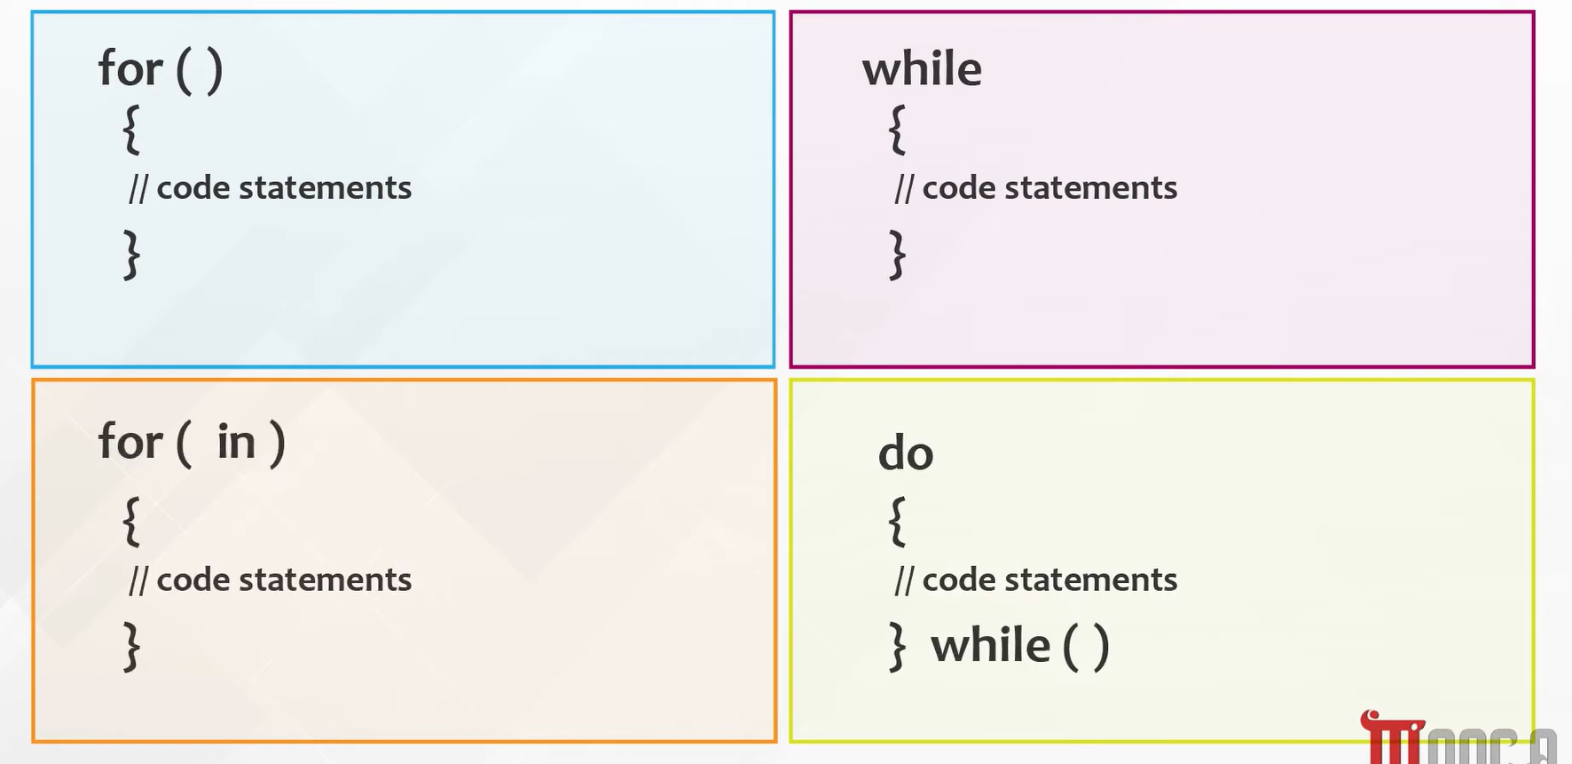
Conditional statement Cont.
Loop statements:

Slide 3
03
Communicate with user
Front-End Web Development Using React – JS

Slide 4
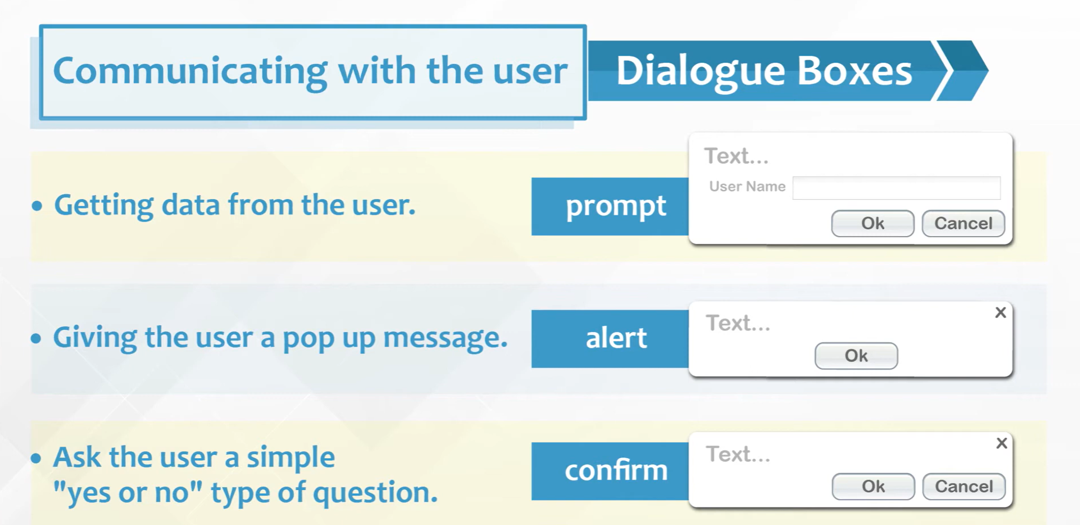
Dialogue boxes

Slide 5
04
Built-in functions
Front-End Web Development Using React – CSSJS

Slide 6
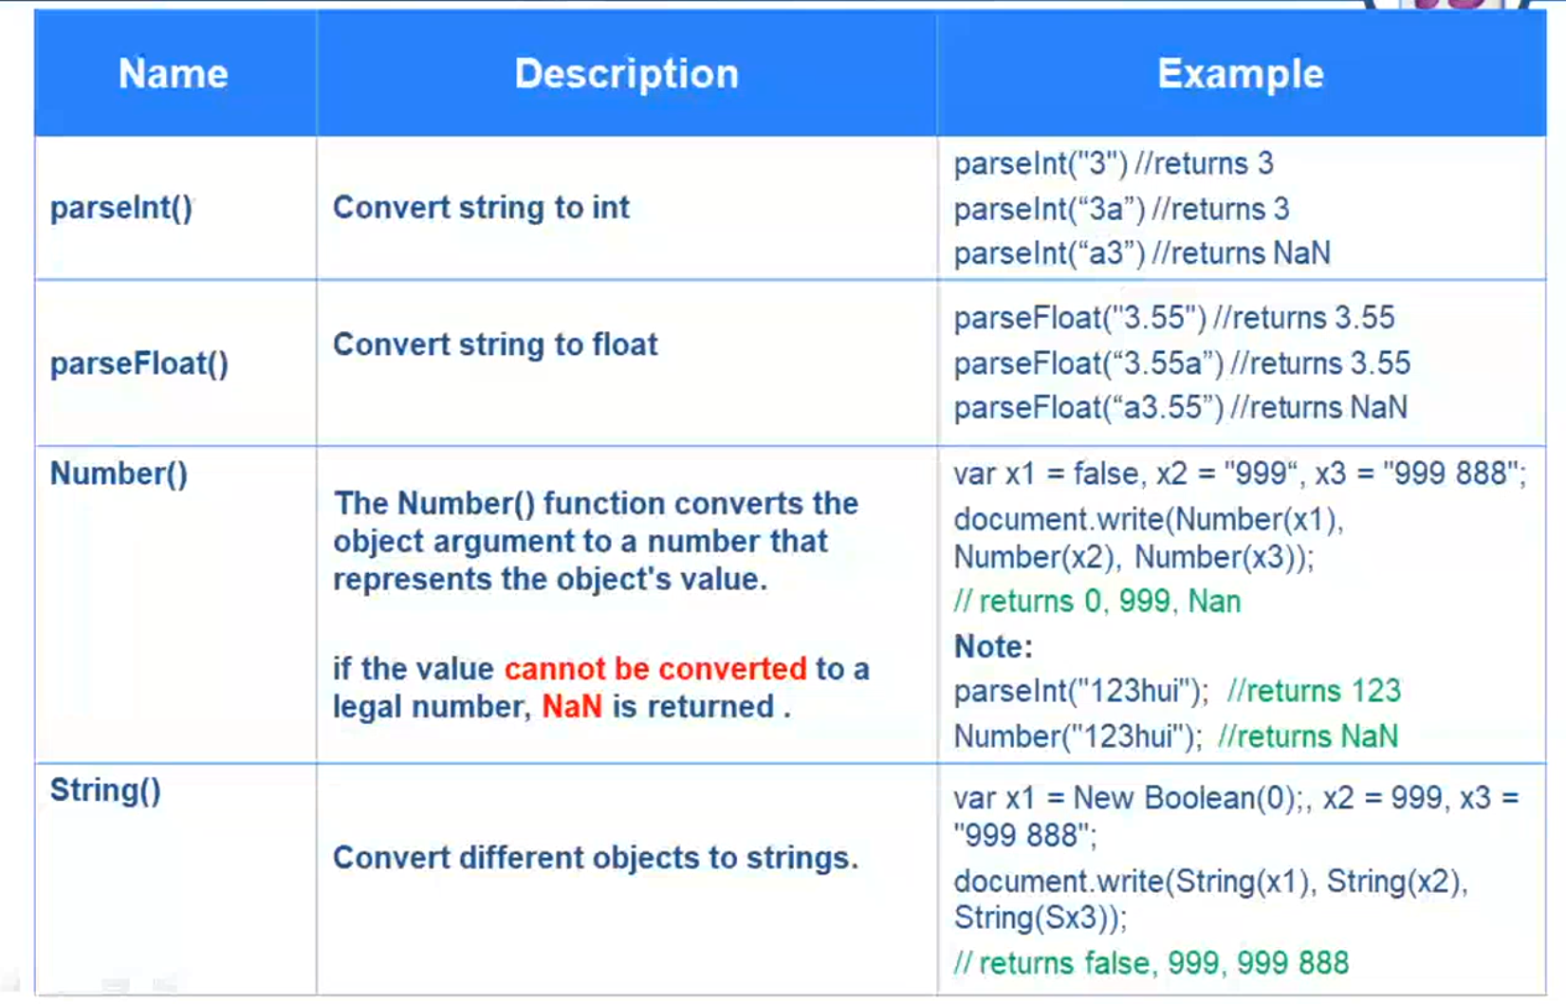
JavaScript built-in functions

Slide 7
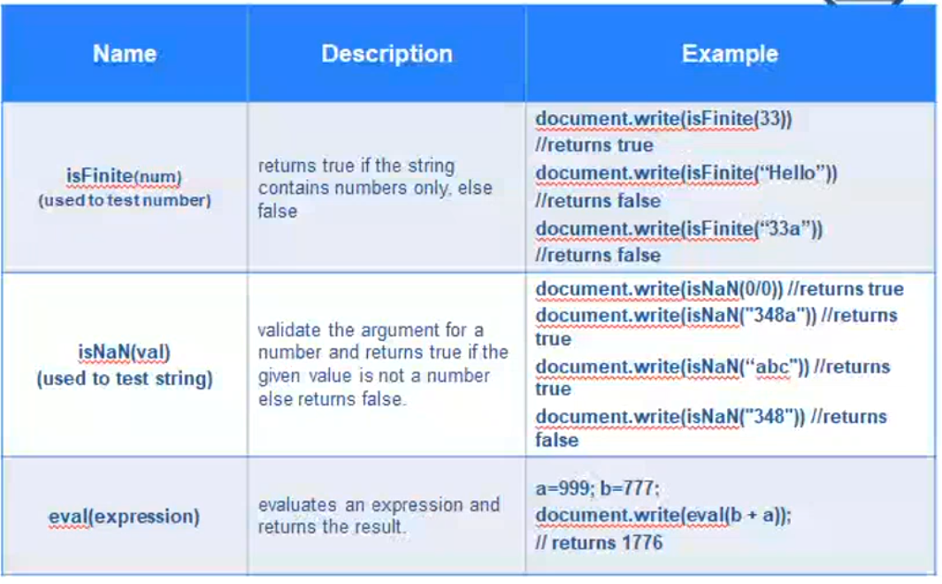
JavaScript built-in functions Cont.

Slide 8
05
Errors and error handling
Front-End Web Development Using React – JS

Slide 9
Error types
Error are usually thrown by the environment (browser) or by the developer ( inside the code)

Slide 10
05
JavaScript Objects
Front-End Web Development Using React – JS

Slide 11
JavaScript objects
Built-in objects
String
RegExp
Number
Math
Array
Date
Boolean
Error
Object

Slide 12
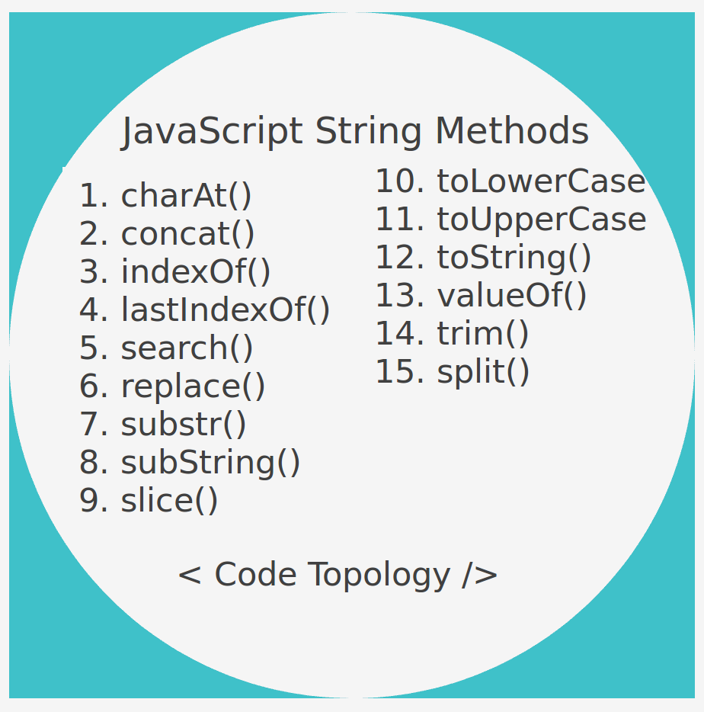
JavaScript objects Cont.
String methods:

Slide 13
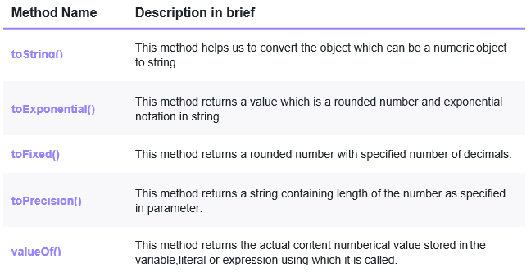
JavaScript objects Cont.
Number methods:

Slide 14
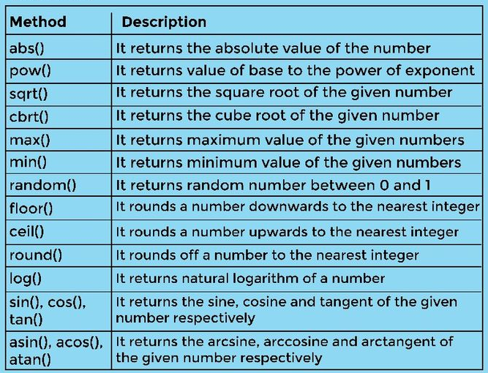
JavaScript objects Cont.
Math methods:

Slide 15
Thanks!
Front-End Web Development Using React – CSS
Does anyone have any question?
ReemHassan160299@gmail.com
+201092427577

